Slide 1
Interruptions on the Medical Units
Nurse-Doctor Co-Teaching Session on GMS
Bertha Lee, PhD, RN and Anuj K. Dalal, MD
Brigham and Women’s Hospital
October 2nd, 2019
Keywords: interruptions, distractions, workplace
Notes:
Hand out Opinionnaire as participants come in.
Helen will introduce us
Bertha welcomes all but gets interrupted by Anuj (MINI-SKIT)
Bertha: “As we have observed, interruptions are widely considered a problem, especially in the workplace such as in the medical units.”

Slide 2
Opinionnaire Questions (Agree or Disagree?)
When I am interrupted, it increases the time it takes me to complete a task because I forget what I was doing.
Not all interruptions are bad. In fact, sometimes, it is necessary to interrupt people.
Multitasking increases my productivity.
I feel annoyed when I am interrupted?
When someone interrupts me, I assume that this person is mindful of the work I am doing.

Slide 3
INTERRUPTIONS in the Workplace
“Interruptions and distractions are a feature of work in most complex sociotechnical systems in which people must handle multiple threads of work.”
(Sanderson, P. M., & Grundgeiger, T., 2015).
“Distractions and interruptions consist of anything that disrupts an individual from the current task by diverting one's attention.”
(Beyea, S., 2014).
“Productivity killers”
“Energy suckers”
“Work satisfaction destroyers”
Notes:
ANUJ: “On GMS, we know that workplace interruptions can include from casual pop-ins to emergent notifications and interrupters from emails, texts, calls, pages, intercoms, alarms, etc., and most of the time, occurring simultaneously.”
Bertha: Beyea describes distractions and interruptions consisting “of anything….” Frequent interruptions have also been described as “productivity killers” and “energy suckers” and “work satisfaction destroyers.”

Slide 4
Back -to- Back Face -to- Face
1. Stand back-to-back with your partner and listen to the question
2. While back-to-back, think of your response to the question for 15 seconds
6. After the 3rd question, we will discuss as a whole group
3. After a ding, face your partner and discuss the question with your partner for 15 seconds
4. After another ding, go back-to-back for the next question
Notes:
ANUJ will explain and demonstrate with Bertha the Back-to-Back and Face-to-Face Protocol. “We know that it’s tight in this room but please feel free to snuggle up as if you are on a packed T.”
Bertha: “Anyone have any questions on this activity?”
Nurse-Doctor pair up (15 seconds per question)
Each question popped on the screen
Conclude as a whole group with volunteers to answer one of the 3 questions (5 mins)
Bertha: “Let’s hear what you have thought about and discussed with your partner. Any volunteers on this side of the room? How about this side?”

Slide 5
Question 1
When do you find yourself being interrupted the most?

Slide 6
Question 2
How do you deal with interruptions?

Slide 7
Question 3
What kind of errors do you worry about when you are interrupted?

Slide 8
SCENARIO 1
Nurse is about to do an 8AM med-pass in a patient’s room when Doctor comes into the patient’s room to tell Nurse that the team is rounding on Nurse’s critical patient first. Nurse decides to round with the team and leaves the patient’s antihypertensive meds at the patient’s bedside. At noon, the PCA reports to Nurse that the patient’s BP was 220/100. When Nurse checks on the patient, she finds the two antihypertensive pills from the morning still sitting on the patient’s bedside table.
Notes:
Bertha: “Now let’s look at a couple of real-life scenarios of workplace interruptions. The first scenario is:….” (Read scenarios SLOWLY)

Slide 9
Reflection
What happened?
Can this be prevented? If so, how?
How often has something similar happened to you?
Notes:
ANUJ: “Turn to the person next to you and reflect about this scenario for a minute. Then, we will ask the group to share some reflections.”
Bertha-include feedback or relatable experiences and think of your own simple questions to further discussion

Slide 10
SCENARIO 2
In the back room, Doctor is reconciling medications on a patient’s discharge summary. Nurse enters the back room to report a critical lab and to ask for immediate changes to the patient’s orders. Simultaneously, Doctor’s beeper goes off while a fellow resident asks Doctor a question on different patient. Doctor returns to Epic and enters orders but forgets to switch to the correct patient.
Notes:
ANUJ: “The second scenario takes place in…”

Slide 11
Reflection
What happened?
Do you think the Doctor will realize his/her mistake?
How long might it take for the Doctor to refocus on the original task?
How do interruptions affect one’s ability to deliver high-quality care?
Notes:
Bertha: “Now, let’s reflect. What happened? Do you think the Doctor realized what they did wrong? How many minutes do you think it will take the doctor to refocus on the original task? How do interruptions affect you ability to provide quality patient care?”
Anuj-include feedback or relatable experiences and think of your own simple questions to further discussion

Slide 12
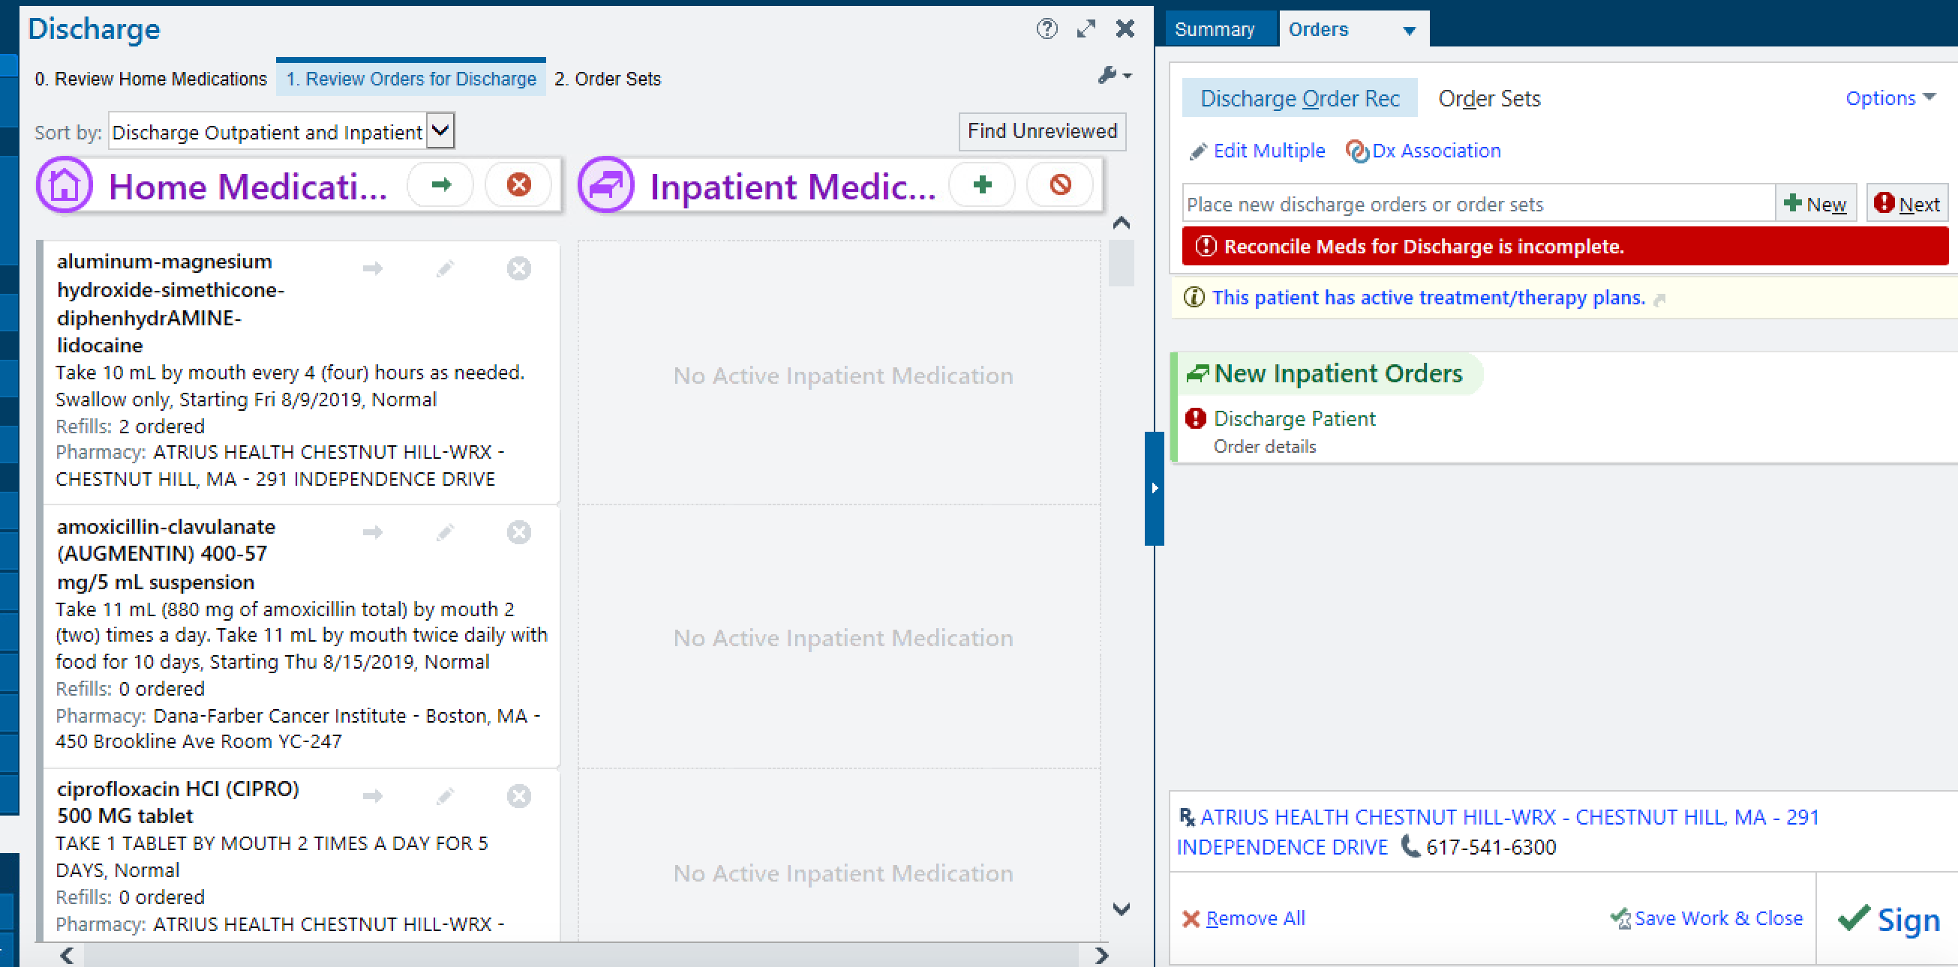
MD’s MED. RECONCILIATION SCREEN
RN at the OMNICELL (Narcotic Count)
Notes:
ANUJ: “The picture on the left is a screenshot of the medication reconciliation screen on EPIC. This is one of the times a doctor should not be interrupted to prevent any future medical errors.”
Bertha: “The picture on the right is a nurse at the omnicell counting back how many narcotics are in the bin prior to removing the amount ordered for the patient. Similarly, this is one of the times a nurse should not be interrupted in order to prevent any medical errors.”

Slide 13
FAST FACTS
A person spends an average of 11 minutes on a task before being interrupted
Work interruptions can cost you at least 6 hours a day
After 1 interruption, refocusing your efforts can take on average 25 minutes
Even after a 2.8-second interruption, error rates doubled
Frequently interrupted workers reported 9% higher exhaustion rates (12% due to work overload)
Effects of work interruptions cost an estimated $588 billion a year in the U.S.
Notes:
ANUJ: “Here are a list of facts based on the literature.”
Bertha: “The first fast fact is…” (say with animation!)

Slide 14
SOLUTIONS
Safety checklist adapted from the airline industry to decrease nurse interruptions and distractions during medication administration (Yoder, M., Schadewald, D., & Dietrich, K., 2015)
A simple, secure electronic health record (EHR) base text paging system to communicate with internal medicine residents (Lapointe, R., Bhesania, S., Tanner, T., Peruri, A., & Mehta, P., 2018)
Educational interruptions, which averaged over 7 pages, decreased from 64% to 16%
Patient care interruptions fell from 68% to 12%
Pharmacists becoming effective health promotion educators (Chandra, A., Malcolm, N., & Fetters, M., 2003)
Notes:
Bertha: Here are some solutions found in the literature. The first one is similar to Atul Gawande’s The Checklist Manifesto book which focuses on the use of checklists in the medical world for greater efficiency, consistency, and safety. The second is an easy text paging system to communicate directly to residents that decreased interruptions in patient care from 68 to 12%. Lastly, the third solution is more of an interdisciplinary approach of collaborating with pharmacists to even educate our patients more.

Slide 15
Strategies for Managing Interruptions
Avoid multitasking
Use a do-not-disturb approach, create a no interruption zone, close doors
Identify a time for necessary interruptions
Set expectations with colleagues, patients, your friends and family
Use checklist approach for high risk, cognitively intense procedures when focus is critical
Admissions
Procedures
Transfer/hand-off
Discharge (e.g., medication reconciliation)
Notes:
ANUJ

Slide 16
Strategies for Managing Interruptions
Manage alerts, alarms, noise
Manage mobile devices
Explore settings
Configure ringers, push notifications, buzzers
System improvements
Provide input and feedback about cognitively demanding tasks
Staff education
Learn and disseminate

Slide 17
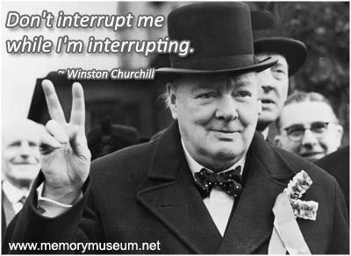
Notes:
Pass along Takeaway Info Sheet
CONCLUDE with SKIT: Act out a solution that shows collegiality (Anuj, give me 5 minutes to complete this task and I will come find you. Thank you!)

Slide 18
References
Beyea, S. (2014). Interruptions and distractions in health care: improved safety with mindfulness. Maryland, USA: Agency for Healthcare Research and Quality.
Chandra, A., Malcolm, N., & Fetters, M. (2003). Practicing health promotion through pharmacy counseling activities. Health Promotion Practice, 4(1), 64-71.
Lapointe, R., Bhesania, S., Tanner, T., Peruri, A., & Mehta, P. (2018). An innovative approach to improve communication and reduce physician stress and burnout in a university affiliated residency program. Journal of Medical Systems, 42(7), 1-6.
Sanderson, P. M., & Grundgeiger, T. (2015). How do interruptions affect clinician performance in healthcare? Negotiating fidelity, control, and potential generalizability in the search for answers. International Journal of Human-Computer Studies, 79, 85-96.
Weigl, M., Müller, A., Vincent, C., Angerer, P., & Sevdalis, N. (2012). The association of workflow interruptions and hospital doctors' workload: a prospective observational study. BMJ Qual Saf, 21(5), 399-407.
Yoder, M., Schadewald, D., & Dietrich, K. (2015). The effect of a safe zone on nurse interruptions, distractions, and medication administration errors. Journal of Infusion Nursing, 38(2), 140-151.
Neiger, P. & Pantz, R. (2017). 6 jaw-dropping facts about workplace interruptions and what you can do. Retrieved from https://trainingmag.com/6-jaw-dropping-facts-about-workplace-interruptions-and-what-you-can-do/.
Westbrook, J. I., Coiera, E., Dunsmuir, W. T., Brown, B. M., Kelk, N., Paoloni, R., & Tran, C. (2010). The impact of interruptions on clinical task completion. BMJ Quality & Safety, 19(4), 284-289.

